Slide 1



Slide 2

Atlantic HURDAT2
The National Hurricane Center (NHC) conducts a post-storm analysis of each tropical cyclone in the Atlantic basin (i.e., North Atlantic Ocean, Gulf of Mexico, and Caribbean Sea) to determine the official assessment of the cyclone's history. (1851-2015)

Slide 3

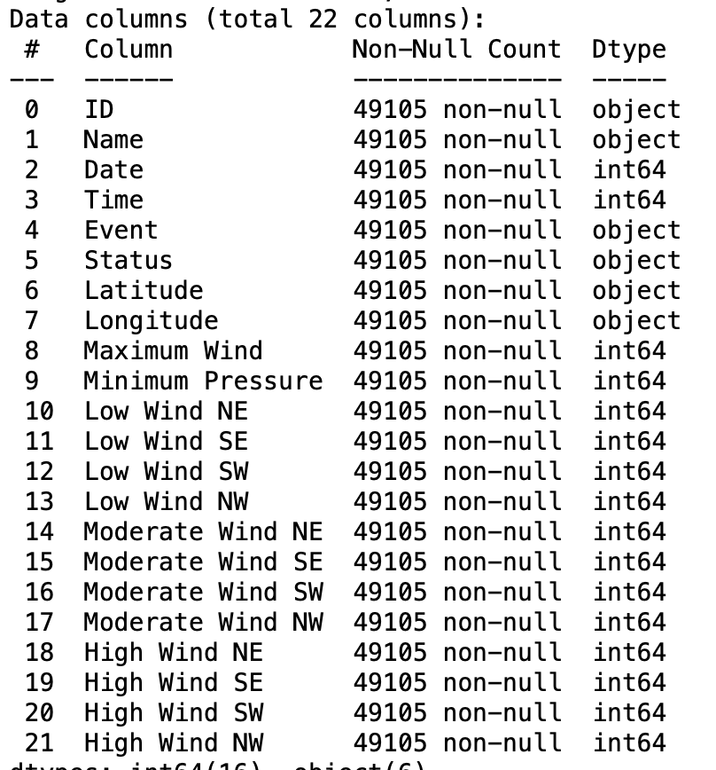

Slide 4

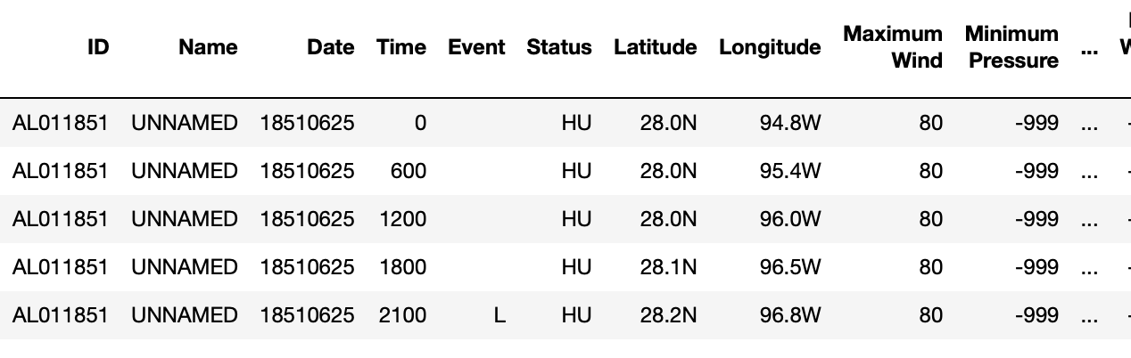
Convert the latitude and longitude Column to numeric type.
Change all time to format HHMM
Add Month and Year Columns
Remove records before year 1900 (Scientists consider the HURDAT2 record to be accurate for landfall statistics from 1900 onward)
Fill missing values (represented by -999) with means

Slide 5

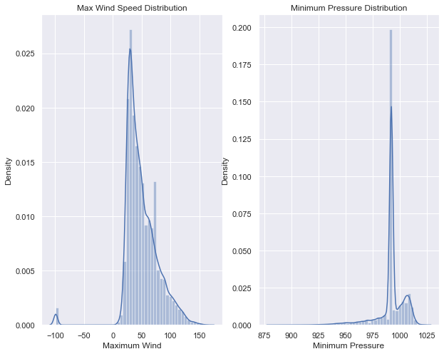

Slide 6

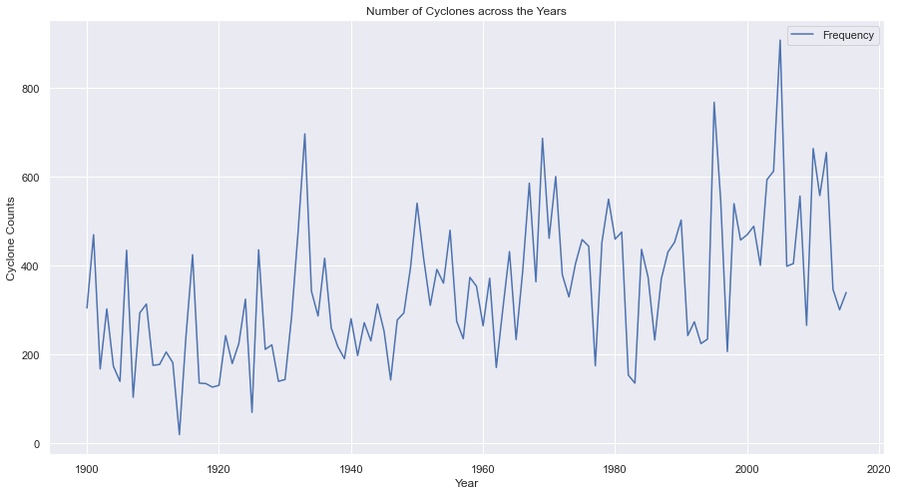

Slide 7
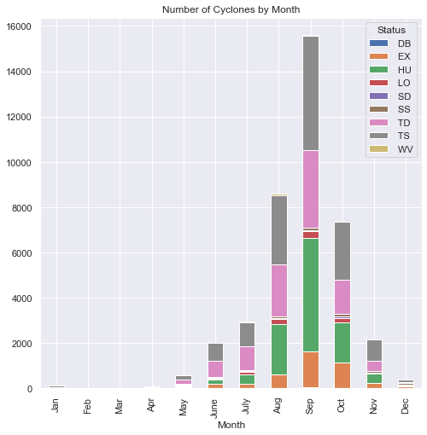
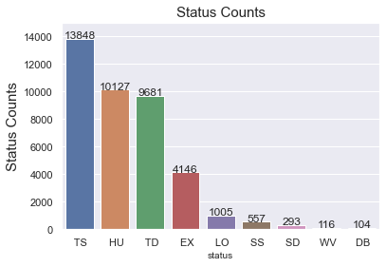

Slide 8
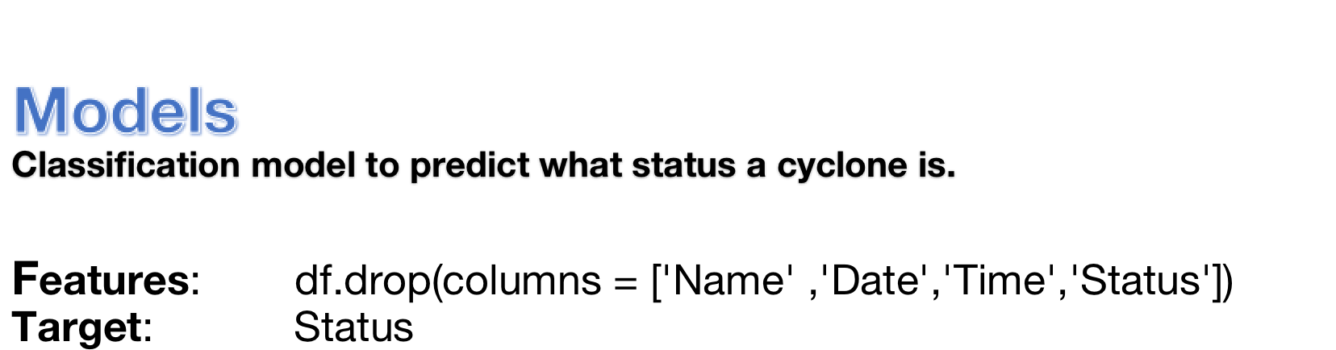
Decision Tree ( max_depth =2 )
Cross Validation Score | 0.84515
Train Score | 0.84525
Test Score | 0.84343
criterion="entropy"
Decision Tree ( max_depth =2 )
Cross Validation Score | 0.84388
Train Score | 0.84388
Test Score | 0.84393
optimize Decision Tree

Slide 9

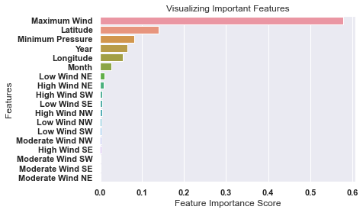
Random Forest Classifier with Feature Selection (n_estimators=10)
Cross Validation Score | 0.94927
Train Score | 0.99809
Test Score | 0.94774
KNN (with all the features)
Cross Validation Score | 0.90153
Train Score | 0.94570
Test Score | 0.90160
KNN (with top 5 features)
Cross Validation Score | 0.90570
Train Score | 0.94573
Test Score | 0.90712

Slide 10

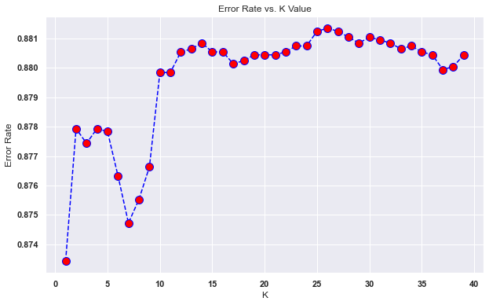
Choose a K value to fine-tune KNN.
Patterns or Similarities in missed predictions.
To be used with loss data to monitor pricing and reserving.

